Slide 1
Hack the Future:
A Gen AI Sprint Powered by Data

Slide 2




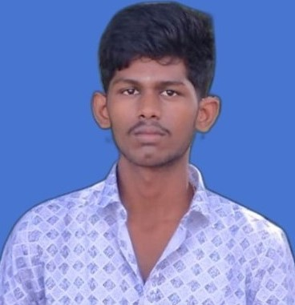
Hack the Future: A Gen AI Sprint Powered by Data
Data and AI Week
Team details
TEAM NAME: MOTIVATE
SHAILESH V
THIYAGAGARAN K
Photo

Slide 3
Entry Submission Summary
Idea Title (Provide a concise and impactful title for your idea.) | Data and AI for Personalized E-Commerce
Team Name | MOTIVATE
Problem Statement | E-commerce platforms face challenges in delivering highly personalized experiences that adapt to users' evolving preferences, behaviors, and purchasing patterns. Traditional recommendation systems often lack contextual memory and real-time adaptability.
Proposed Solution | We propose a Multi-Agent System (MAS) powered by Data Science and AI to simulate and enhance personalized shopping experiences. This solution integrates behavioral data analysis, long-term user memory, and adaptive recommendation mechanisms.

Slide 4
Problem statement you are trying to address
E-commerce platforms face challenges in delivering highly personalized experiences that adapt to users' evolving preferences, behaviors, and purchasing patterns. Traditional recommendation systems often lack contextual memory and real-time adaptability.
The rapid growth of online shoppers has led to an overwhelming abundance of choices, making it increasingly difficult for users to discover relevant products efficiently. Many recommendation engines rely on static algorithms that fail to capture the dynamic nature of user interests over time, resulting in generic suggestions and reduced customer engagement. These systems often overlook important behavioral signals such as time-of-day activity, product revisit patterns, and multi-device usage. Without the ability to learn continuously and adapt to user context, traditional systems struggle to maintain long-term relevance and customer satisfaction in a competitive e-commerce landscape.

Slide 5
Proposed Solution Overview
Brief approach description or methodology used to tackle the problem
We propose a Multi-Agent System (MAS) powered by Data Science and AI to simulate and enhance personalized shopping experiences. This solution integrates behavioral data analysis, long-term user memory, and adaptive recommendation mechanisms.

Slide 6
Technologies Used
List the key technologies, frameworks, and tools you utilized in your solution
Python
Data Science
Machine Learning
SQLite
NetworkX
Matplotlib
Multi-Agent System

Slide 7
Agents' interaction design
Enable collaborative, intelligent behavior among autonomous agents to provide context-aware, personalized product recommendations based on user interactions and preferences.
UserAgent → MemoryAgent: Log product interaction (view/click/purchase)
UserAgent → RecommendationAgent: Request product recommendations
RecommendationAgent → MemoryAgent: Retrieve user history & product data
RecommendationAgent → AnalyticsAgent: Request trend analysis or user similarity (optional)
AnalyticsAgent → RecommendationAgent: Return behavioral insights
RecommendationAgent → UserAgent: Send personalized recommendations
UserAgent → MemoryAgent: Log feedback on recommendations (click/purchase)

Slide 8
Code structure
class UserAgent:
def __init__(self, user_id, name, memory_agent):
...
def interact_with_product(self, product_id, action):
# Logs interaction to memory agent
...
def get_recommendations(self, recommender):
# Requests personalized suggestions
...

Slide 9
import sqlite3
class MemoryAgent:
def __init__(self, db_path="db/ecommerce_memory.db"):
...
def store_interaction(self, user_id, product_id, action, timestamp):
...
def get_user_history(self, user_id):
...
def get_product_stats(self, product_id):
...
import random
from utils.ml_models import collaborative_filtering
class RecommendationAgent:
def __init__(self, memory_agent):
...
def recommend(self, user_id):
# Uses ML or heuristics to suggest products
...

Slide 10
class AnalyticsAgent:
def analyze_trends(self):
# Clustering, similarity scoring, etc.
...
import matplotlib.pyplot as plt
import networkx as nx
def visualize_user_network(visualization_df):
# Create graph of agent interactions
...
def visualize_user_history(history):
# Plot timestamped user-product interaction
...
def collaborative_filtering(user_history):
# Placeholder for ML logic (cosine similarity, etc.)
...

Slide 11
-- SQLite tables for users, products, history, recommendations
CREATE TABLE IF NOT EXISTS users (...);
CREATE TABLE IF NOT EXISTS products (...);
CREATE TABLE IF NOT EXISTS user_history (...);
CREATE TABLE IF NOT EXISTS recommendations (...);

Slide 12
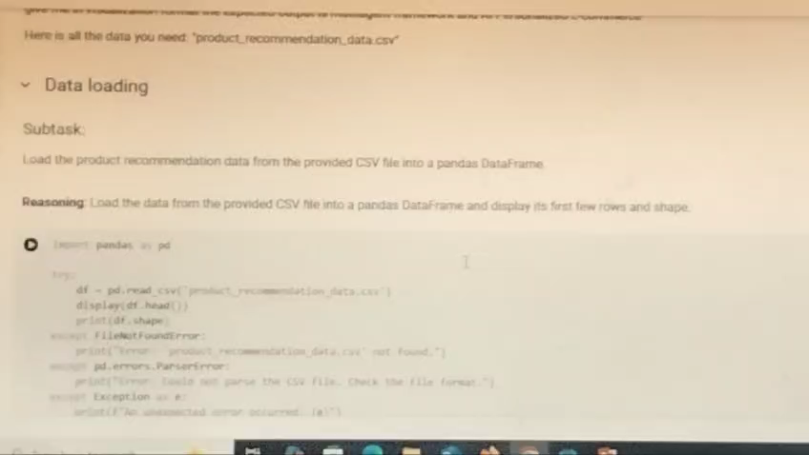
Demo video

Slide 13
Conclusion
Summarize the impact and effectiveness of your solution. Reiterate how it solves the problem statement
.
The proposed Multi-Agent System (MAS), empowered by Data Science, Machine Learning, and a SQLite-based long-term memory, provides a scalable and intelligent framework for delivering personalized e-commerce experiences. By simulating user behavior, analyzing contextual and historical data, and enabling agents to interact dynamically, this solution bridges the gap between static recommendation systems and adaptive, user-centered shopping experiences.
The integration of behavioral data analysis, agent collaboration, and data-driven decision-making allows the system to not only recommend products more accurately but also to adapt in real-time as user preferences evolve. Visualizing user-agent interactions and product affinity further enhances transparency and interpretability. This approach demonstrates how AI-powered multi-agent architectures can revolutionize personalization in digital commerce.

Slide 14
References/Other details
Russell, S., & Norvig, P. (2020). Artificial Intelligence: A Modern Approach. Pearson Education.
Aggarwal, C. C. (2016). Recommender Systems: The Textbook. Springer.
Chakraborty, S., & Mehrotra, D. (2022). Applied Machine Learning and AI for E-Commerce: Tools and Techniques. Wiley.
SQLite Documentation: https://www.sqlite.org/docs.html
Pandas, NumPy, NetworkX, Matplotlib Documentation:
https://pandas.pydata.org/docs/
https://numpy.org/doc/
https://networkx.org/documentation/
https://matplotlib.org/stable/index.html

Slide 15

Thank You

